Slide 1
AVIATION SAFETY AND CERTIFICATION OF NEW OPERATIONS AND SYSTEMS
WP 6
Dissemination / Exploitation / User Group

Slide 2
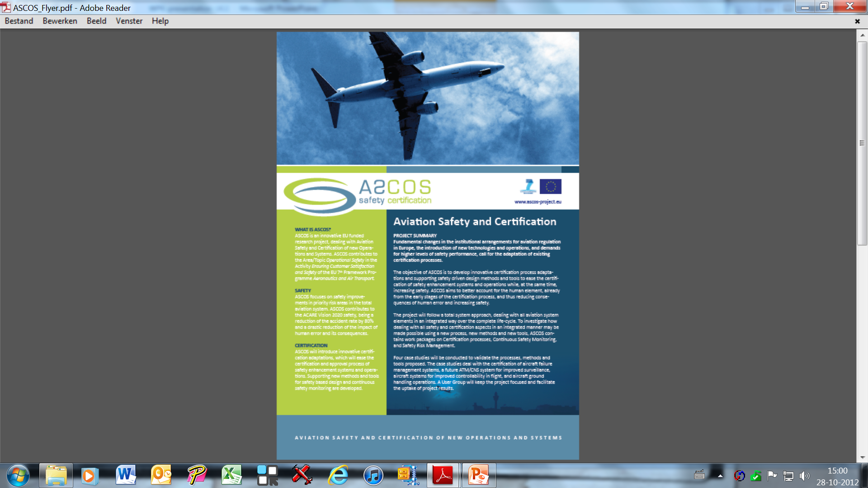
1
Dissemination
Public Flyer and Brochure

Slide 3
Plan

Slide 4
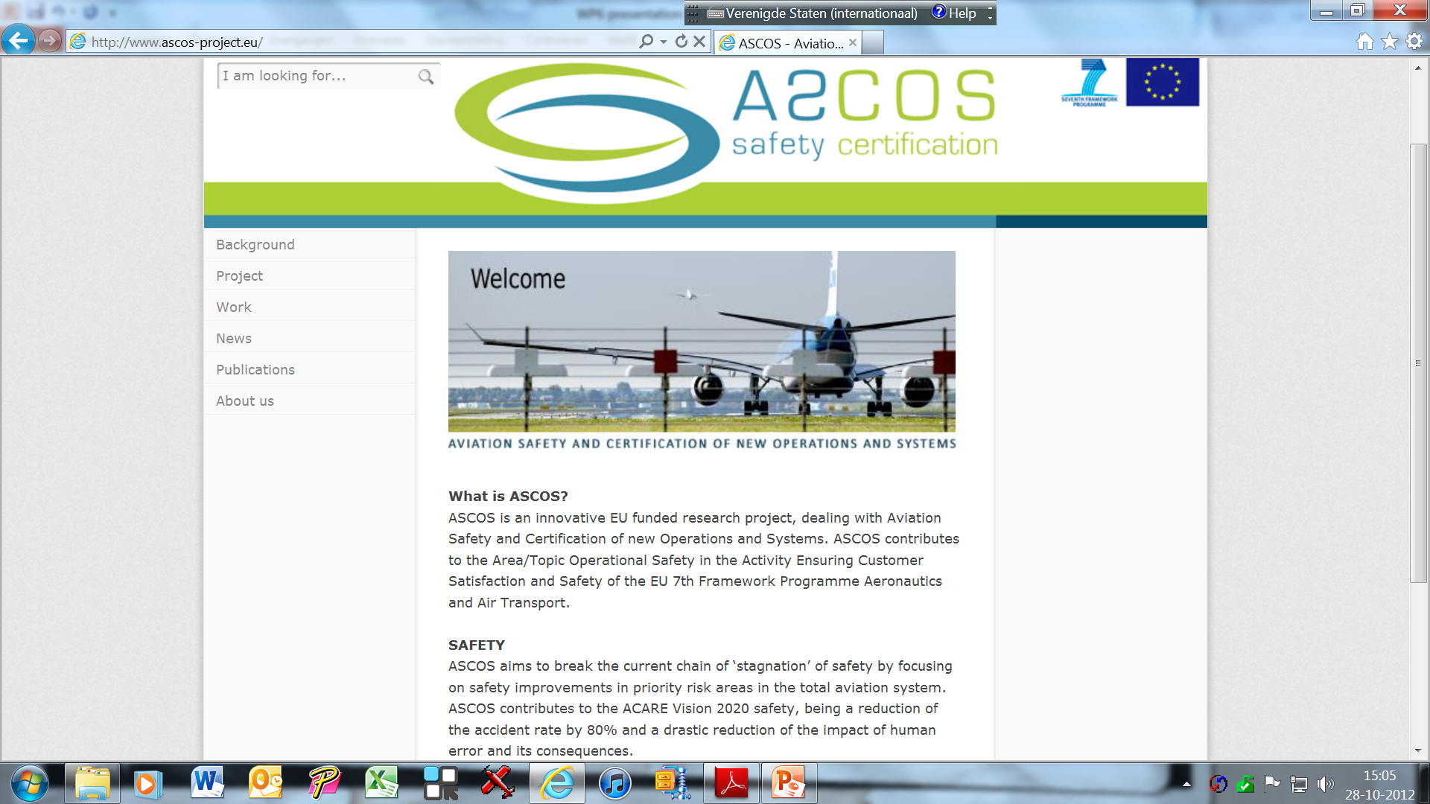
Plan

Slide 5
EXPLOITATION
An assessment of the potential to exploit the project results
An exploitation plan for market take-up
An evaluation of the e-learning web-environment
Evaluation of the safety based design systems and tools with its potential users
Evaluation of the capability to improve existing Safety Management Systems

Slide 6
User Group
Will be kept informed about the project and will be able to provide input and feedback on results by:
A yearly workshop
A peer review of selected deliverables
Support of ASCOS with availability of air safety incident/accident data
Orientations and verification of preliminary results

Slide 7
Aviation Safety and Certification of new Operations and Systems

